Slide 1
Mentorship
Strengthening Texas York Rite Masonry

Slide 2
Reasons New Companions Fall Away
Health issues
Job-related reasons
Lack of support
Feeling unwanted/unneeded
Divisiveness or contention in the Chapter or Council
Finding no value in attending meetings
Low quality of ritual work
Other?

Slide 3
What is a Mentor?
A guide to the candidate during his journey through the veils
Support for newly exalted/greeted Companions
A resource to draw on for questions and advice
Most importantly, a friend!
Who can be a mentor? Everyone!

Slide 4
Why Mentor?
Helps candidates and new Companions feel welcome
Strengthens the bond between Companions and their Chapter and Council
Encourages active participation and engagement
Encourages further growth and development
Replace yourself

Slide 5
Mentorship Rule #1
BE THERE!

Slide 6
Where Do We Start?
Encourage your elected officers to start a formal mentorship program
Appoint a mentor committee to oversee the program
Develop and document a mentorship program that meets the needs of your Chapter and Council

Slide 7
Mentorship Program
During the Degrees:
Assign a mentor before the Mark Master degree
Ensure the mentor (or his designee) is present at EACH degree
Accompany your candidate to the festival (if applicable)
Take the time to explain the room layout and officer titles for each degree
Schedule time after each degree to meet and discuss

Slide 8
Mentorship Program (Continued)
After the Degrees:
Ensure the new Companion has a current ritual and monitor
Ensure the new Companion is not immediately thrust into an elected office. Give them time to mature.
Encourage the Companion to attend stated meetings
Get the Companion involved in working on a degree team, serving on a committee, or participating in the appointed officer line
Take the Companion to one or more York Rite Conferences
Encourage the Companion to attend schools of instruction and the Grand Sessions

Slide 9
Q&A

Slide 10
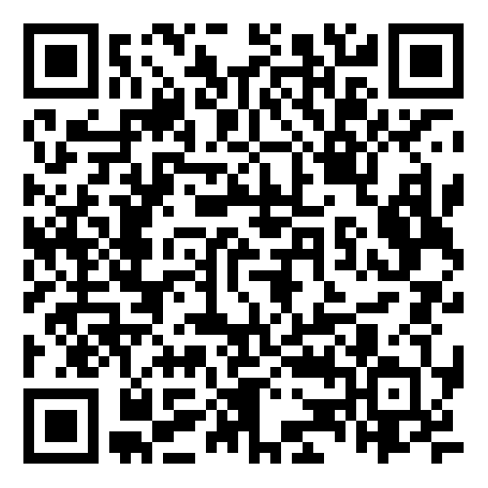
Scan to download

